Slide 1
Course | Python for Data Science
Term
Class
Date
Chapter. Topic
What is data science?
Siva R Jasthi
Computer Science and Cybersecurity
Metropolitan State University

Slide 2
Outline
What is Data Science?
Why Data Science?
Data Science Process
Data Sources

Slide 3
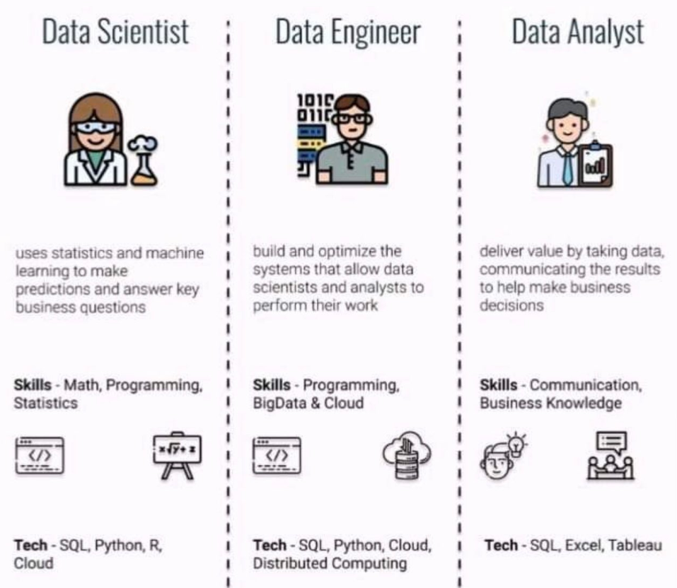
Data _______?
Data Scientist
Data Analyst
Data Engineer
ML Engineer
https://pbs.twimg.com/media/FBlstfBXoAAuJWz.jpg:large

Slide 4
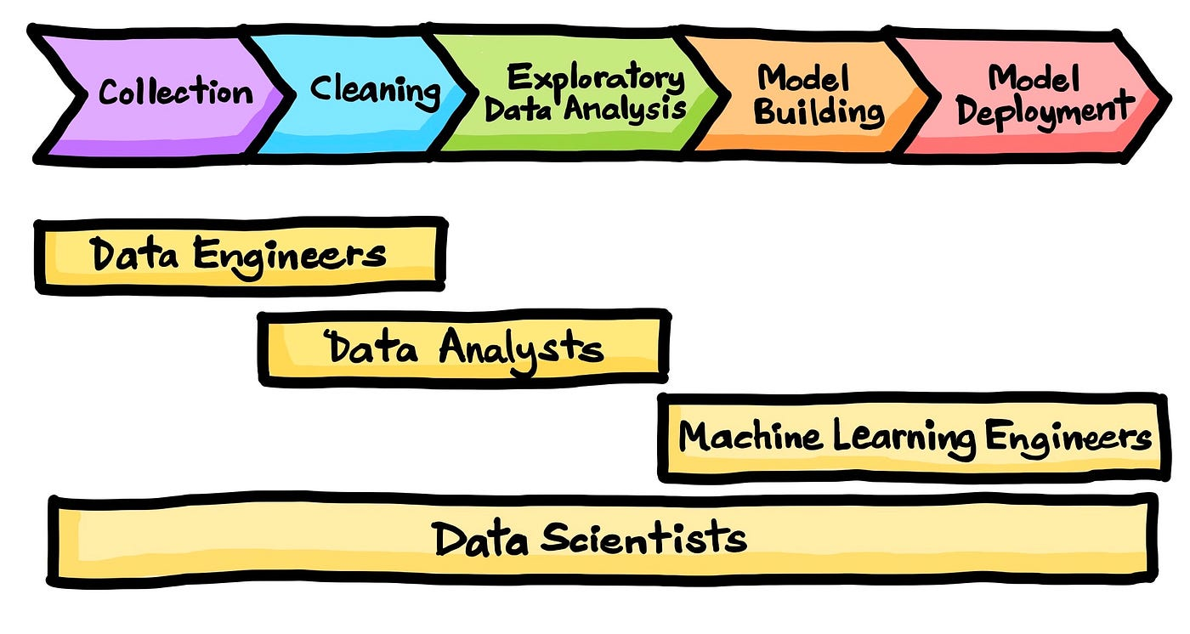
Data Science Process
https://dataprofessor.beehiiv.com/p/the-data-science-process

Slide 5
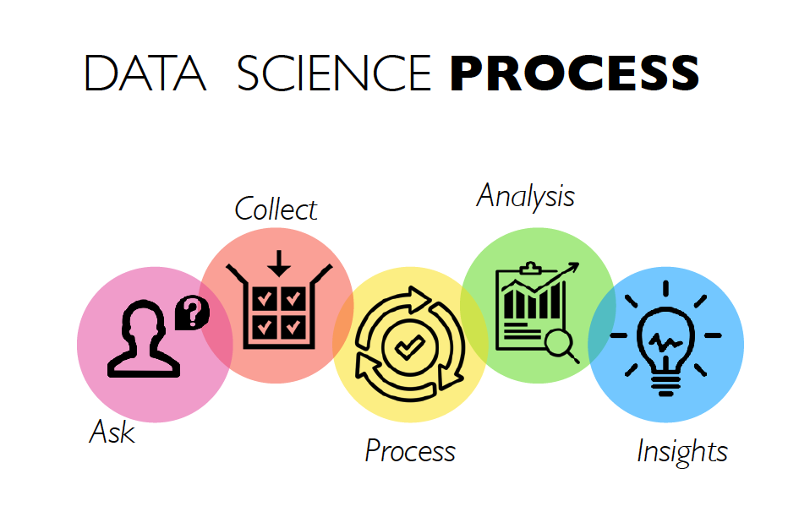
https://www.yellowslice.in/bed/data-science-design-thinking-process-of-amalgamation-to-perfection/

Slide 6
The Data Science Process
Ask an interesting question
Get the Data
Explore the Data
Model the Data
Communicate/Visualize the Results

Slide 7
Some interesting questions
Ask an interesting question
Sports: "Which factors contribute most to a basketball team's success?“
Environment: "Is air pollution worse in urban areas compared to rural areas?“
Entertainment: "What types of movies are most popular during different times of the year?“
Health: "Does eating breakfast affect students' performance in school?“
Weather: "How does weather impact people's mood or productivity?“
Social Media: "What time of day gets the most engagement on social media?“
Shopping: "Do people spend more money on shopping during weekends compared to weekdays?

Slide 8
Some interesting questions (Contd.)
Ask an interesting question
Education: "Do people with higher levels of education (college vs. high school) have higher average salaries?“
College Majors: "Which college majors lead to the highest-paying jobs?“
Job Market: "How does the unemployment rate vary by education level?“
Degree Importance: "Is there a strong correlation between having a college degree and job satisfaction?“
Job Opportunities: "What industries hire the most college graduates?“
College vs. Trade School: "Do trade school graduates find jobs faster than college graduates?“
Job Stability: "Are people with college degrees less likely to change jobs compared to those without degrees?"

Slide 9
How to get the Data?
Get the Data
You create it
- creating it from scratch
Someone else provides it, all pre-packaged for you (e.g., files)
- sheroes_data.xlsx
Someone else gives you access through an API or Key to get the data
https://www.projectabcd.com/api/getinfo.php?id=50 (gets the JSON data)
Someone else has content on web and you scrape it.
https://www.projectabcd.com/display_the_dress.php?id=50 (html)

Slide 10
How to get the Data? Google the question
Get the Data
College Majors: "Which college majors lead to the highest-paying jobs?”
https://www.kaggle.com/code/suugaku/dataquest-visualizing-earnings-by-college-major/input

Slide 11
Some popular data sources
See the document “Where to get data for Data Science and Machine Learning?”

Slide 12
Types of Data Sources
1. Structured Data Sources
Relational Databases (RDBMS): Data stored in structured tables, e.g., MySQL, PostgreSQL, Microsoft SQL Server, and Oracle.
Data Warehouses: Centralized repositories of integrated data from multiple sources, often used for analytics, e.g., Amazon Redshift, Google BigQuery, Snowflake.
Spreadsheets: Simple structured data stored in formats like Excel (.xls), CSV, or Google Sheets.
2. Unstructured Data Sources
Text Data: Documents, emails, and chat logs, often stored in file formats like .txt, .pdf, or sourced from APIs (social media, web scraping).
Multimedia Data: Images, audio, and video files sourced from cameras, sensors, or streaming platforms.
Social Media Data: Platforms like Twitter, Facebook, and Instagram, providing unstructured data through APIs for text, images, and videos.
Log Files: System or application logs that record events, errors, or user activity (e.g., web server logs).

Slide 13
Types of Data Sources
3. Semi-Structured Data Sources
JSON and XML Files: Used for API responses, web data, or configuration files, where data is not fully structured but follows a pattern.
NoSQL Databases: Databases that handle semi-structured or unstructured data, such as MongoDB, Cassandra, and HBase.
4. Real-Time Data Sources
Streaming Data: Data that arrives in continuous flows from sensors, financial tickers, social media streams, and other real-time systems. Examples include Apache Kafka, AWS Kinesis, and Azure Stream Analytics.
IoT (Internet of Things) Devices: Data collected from interconnected devices like smart appliances, wearables, or industrial sensors.

Slide 14
Types of Data Sources
5. Open Data Sources
Public Datasets: Free-to-use datasets provided by governments, international organizations, and research institutions, such as datasets from Kaggle, UCI Machine Learning Repository, or government portals (data.gov).
Open APIs: APIs provided by organizations or platforms for free or paid access to data, such as weather data, financial data, or healthcare data (e.g., NASA APIs, World Bank APIs).
6. Web Data
Web Scraping: Extracting data from websites, typically unstructured or semi-structured, using tools like BeautifulSoup, Scrapy, or Selenium.
RSS Feeds: Syndicated web content in XML format, often used to gather news, blogs, or updates

Slide 15
Types of Data Sources
7. Cloud Data Sources
Cloud Storage Services: Services like AWS S3, Google Cloud Storage, and Azure Blob Storage for storing large datasets in the cloud.
Cloud Databases: Managed databases and data platforms provided by cloud providers, such as Google BigQuery, Amazon RDS, and Microsoft Azure SQL.
8. Geospatial Data Sources
GIS Data: Data with geographic or spatial components, often from GPS systems, satellites, or geographic information systems (GIS). Examples include OpenStreetMap, Google Maps API, and ESRI datasets.
Remote Sensing Data: Data collected from sensors, drones, or satellites (e.g., Landsat satellite data).

Slide 16
Types of Data Sources
9. Sensor Data
IoT and Wearable Devices: Data collected from physical devices, including smartwatches, fitness trackers, or smart home systems.
Industrial Sensors: Used in manufacturing, agriculture, or healthcare to monitor conditions and collect data.

Slide 17
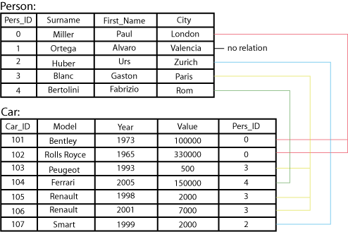
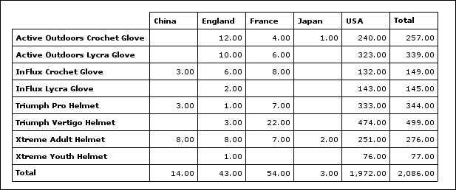
Types of Data Sets: (1) Record Data
Relational records
Relational tables, highly structured
Data matrix, e.g., numerical matrix, crosstabs
Transaction data
Document data: Term-frequency vector (matrix) of text documents

Slide 18
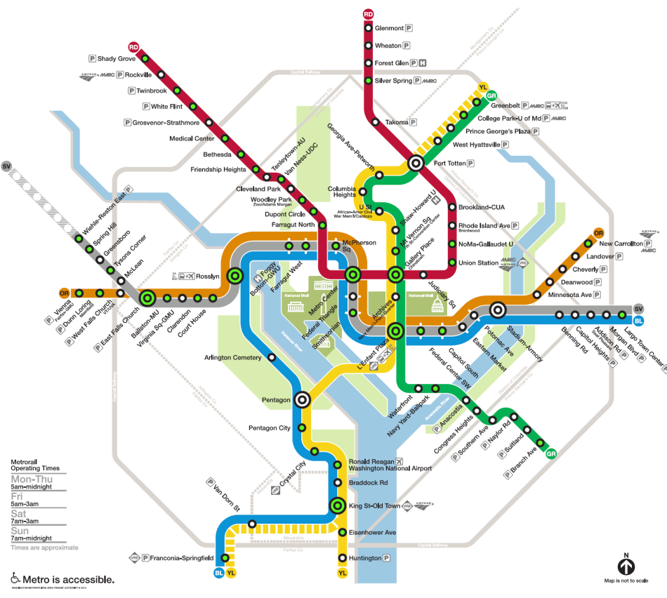
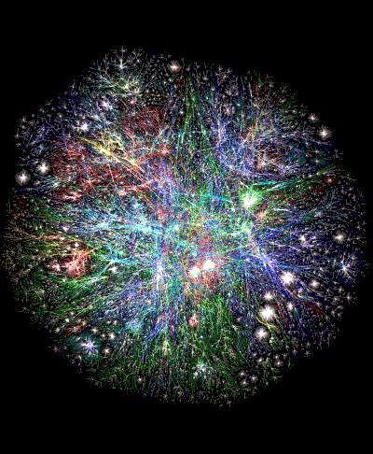
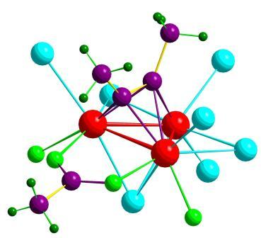
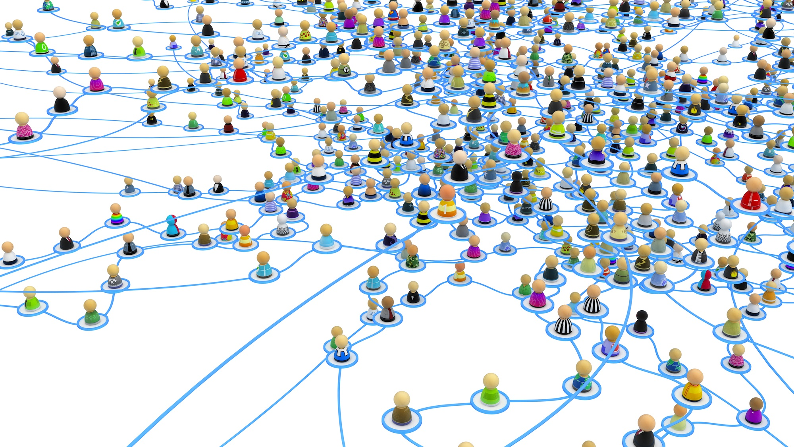
Types of Data Sets: (2) Graphs and Networks
Transportation network
World Wide Web
Molecular Structures
Social or information networks

Slide 19

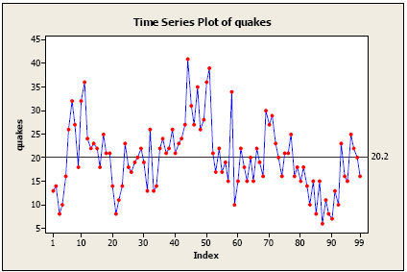
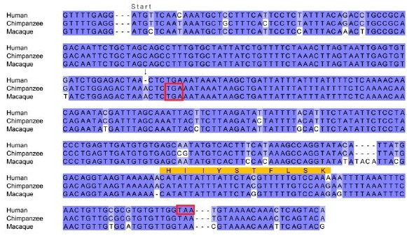
Types of Data Sets: (3) Ordered Data
Video data: sequence of images
Temporal data: time-series
Sequential Data: transaction sequences
Genetic sequence data

Slide 20
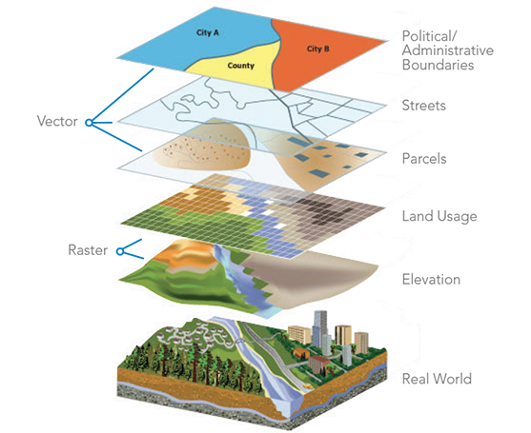

Types of Data Sets: (4) Spatial, image and multimedia Data
Spatial data: maps
Image data:
Video data:

Slide 21
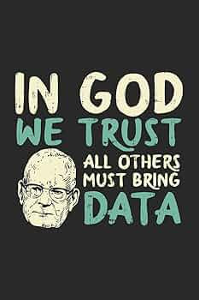
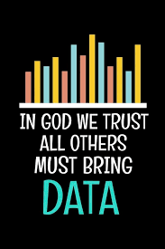
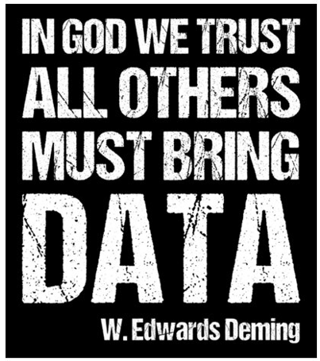
Summary

Slide 22

Thank You.

